Slide 1
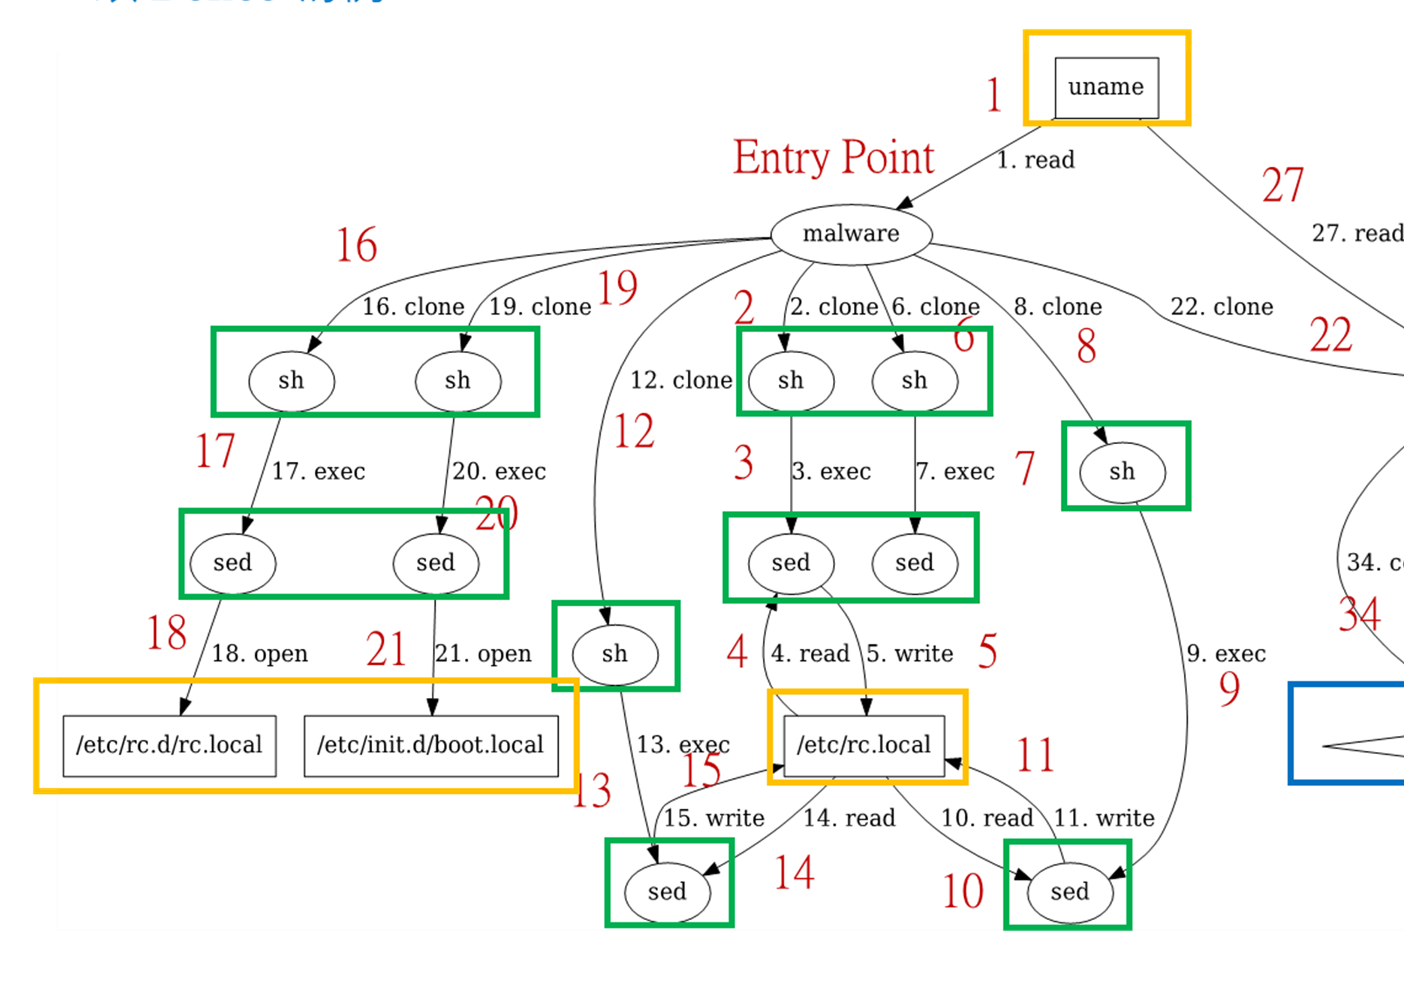

CTI Document Quality Evaluation System
Evaluation Results
Syscall to ASG steps
Engine
Input
Quality Metrics
Γ_{obj}
Γ _{rsc}
Ф_{op}
Ф _{sys}
Attack Flow Diagram
< syscall, object >
Matched ASG steps
___
___
___
Preprocess
Engine
___
___
___
CTI Doc Search
Engine
___
___
___
1
Semantic Gap Bridging Engine
CTI Quality Evaluation
System
set of Attack Activity (AA) Descriptions
Output
Subject
CTI Doc
Data
segments
___
___
Regex
Set
Attack Scenario Graph Generation System
Profiling
System
Attack
Scenario
Graph (ASG) Generator
Doc Search Regex Generator
___
___
___
Subject
malware
sample
System call trace
Attack Scenario Graph
Doc Search
Rule Base
(collect from TLDP &
man7 website)
Notes:
兩個系統:
ASG系統負責，將動態分析的結果事實，轉成 search regex 供搜尋文件之用。
QE系統，負責解析文件中提到的 attack activity，計算並產出 Eval Result。
Γ_{obj}
Γ_{rsc}
Φ_{op}
Φ_{sys}

